Slide 1
Why Developers should love PowerShell
Kurt Kroeker

Slide 2



About Kurt
Sr. Software Developer at EnergyCAP, Inc. for 11 years
Lifelong Stage College, PA resident
Father of 4
Fiddler and multi-instrumentalist

Slide 3
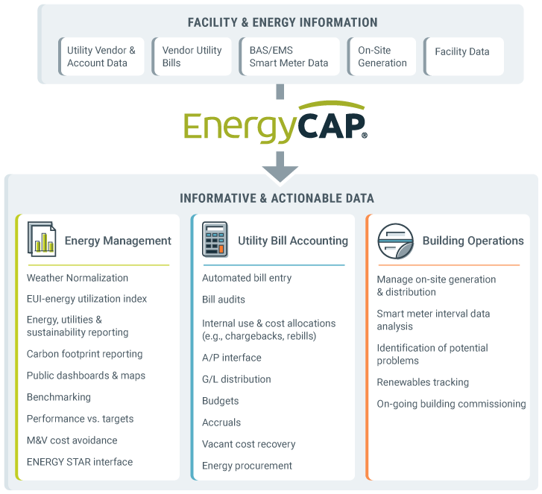
About EnergyCAP

Slide 4

About This Talk
Agenda
Talking
Kurt’s PowerShell Background
Why YOU should care about PowerShell
Demos
PowerShell Basics
Tips working with PowerShell
Resources
Q & A
This Photo by Unknown Author is licensed under CC BY-SA

Slide 5



Slide 6
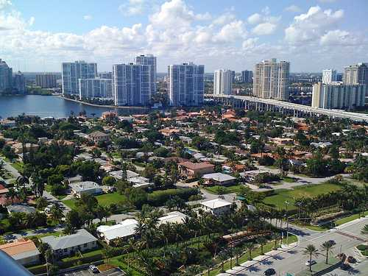


My Background with PowerShell
EDI
apis
audits
reformatter
reformatter
reformatter
reformatter
logging

Slide 7

Why should I care about PowerShell?
It is POWERFUL
It is EVERYWHERE
It is FAMILIAR

Slide 8
What is PowerShell?

Slide 9
PowerShell Concepts
PowerShell Console
Commandlets
Aliases
Variables
Script files
Functions
Operators
Pipelines

Slide 10
Tips Working with PowerShell
The tab key
Pipelines and $_.
Your PowerShell Profile
Up/Down arrows
Hash tables
Working with JSON, CSV, and XML
PowerShell ISE (and VS Code!)
Get-Help, -Command, -Member

Slide 11
Gotchas
Working with strings
Error handling with $Error
PowerShell and TLS
ExecutionPolicy
Old code on the internet
Relative path handling

Slide 12
Subjects Not Demoed
Azure resource interactions
PC user and administrative management
GUIs and PowerShell
PSCustomObject creation
Using external DLLs (Add-Type)
“Splatting” arguments
Write-Debug, Write-Progress, Write-*

Slide 13
Q & A

Slide 14
Resources
PowerShell Core project
https://github.com/PowerShell/PowerShell
Microsoft PowerShell SDK Docs
https://docs.microsoft.com/en-us/powershell/scripting/developer/windows-powershell?view=powershell-6
PS Gallery
https://www.powershellgallery.com
PowerShell 6 Cheat Sheet
https://ilovepowershell.com/powershell-cheat-sheet/
Unit Testing PS with Pester
https://devblogs.microsoft.com/scripting/what-is-pester-and-why-should-i-care/
ExecutionPolicy Management
https://docs.microsoft.com/en-us/powershell/module/microsoft.powershell.security/set-executionpolicy?view=powershell-6

Slide 15

Kurt Kroeker Sr. Software Engineer EnergyCAP, Inc.
Email: kurt.kroeker@energycap.com
Twitter: KurtKroeker

